Slide 1
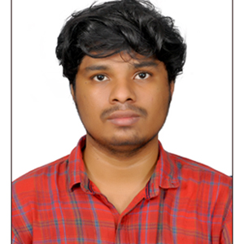
Jegan R
Bachelor Of Technology (Computer Science And Engineering):2017-2021
Analyst/Software Engineer
Bangalore
Skills
Core Java
•Spring Boot
•Spring MVC
•MongoDB
•Bootstrap
Backend
•Spring Boot/Spring Security
•MongoDB
•REST-API
Database
•No SQL database –MongoDB
Web Technologies
•HTML5
•CSS3
•JavaScript/TypeScript
Add-Ons
•GitHub
•Maven
•Postman
Additional Details
•Good Communication Skills
•Team Player
jegan.r@capgemini.com
+91 9080798658
A4
Eager to work in a team of dedicated people and serve a key role in the enhancement and development of the project.
Ready to learn new technologies and implement them to further improve my knowledge.
Has working knowledge on ReactJS and Java Microservice Development using Spring framework on an intermediate level.
Good knowledge on Java 8 and OOPs concepts.
Implemented Web API and React in case study and up skilling this knowledge continuously.
HealthKart Clone - Completed the Case study HealthKart Clone Using Spring Boot Microservices with Eureka Server and spring security along with JWT authentication for login system as middleware, & MongoDB as database. Html & CSS Used for User Interface with ReactJs.
Completed Java Full Stack Developer in Degreed Platform course.
Completed Level 0 in Cert-a-Thon
Certified as Java Entry Level Developer Level 1 and Level 2 as a part OCEAN.
Selected for Signant Health Project and started to work in the project from August 2022.

